Slide 1
Capstone Project
Neighbourhood Comparison

Slide 2
Capstone Project
Problem Definition
In this project we will compare how similar or dissimilar are Downtown Singapore and Manhattan, with the goal to find a rental apartment in Manhattan which meets the following demands:
apartment must be 2 or 3 bedrooms
desired location is near a metro station in the Manhattan area and within 1.5 mile radius
rent price should not exceed 8.000$ per month
top amenities in the selected neighbourhood
desirable to have venues such as coffee shops, restaurants, wine stores, gym and food shops

Slide 3
Capstone Project
Data Description
In order to make a good choice for an apartment in Manhattan, the following data is required:
List of neighbourhoods in Manhattan with their Geodata (latitude and longitude)
List of the subway metro stations in Manhattan with geodata https://en.wikipedia.org/wiki/List_of_New_York_City_Subway_stations_in_Manhattan & https://www.google.com/maps/search/manhattan+subway+metro+stations/@40.7837297,-74.1033043,11z/data=!3m1!4b1
List of apartments for rent in Manhattan with descriptions (number of beds, price, location, address etc.) http://www.rentmanhattan.com/index.cfm?page=search&state=results & https://www.realtor.com/apartments/Manhattan_NY
Venues and amenities in the neighbourhoods
Methodology
The methodology is based on mapping the data in different ways, thus allowing throughout the use of a visual approach, i.e. by means of maps with popups labels, a quick identification of apartments according to the demands

Slide 4
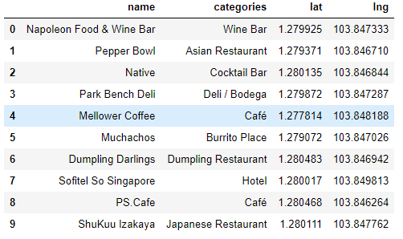
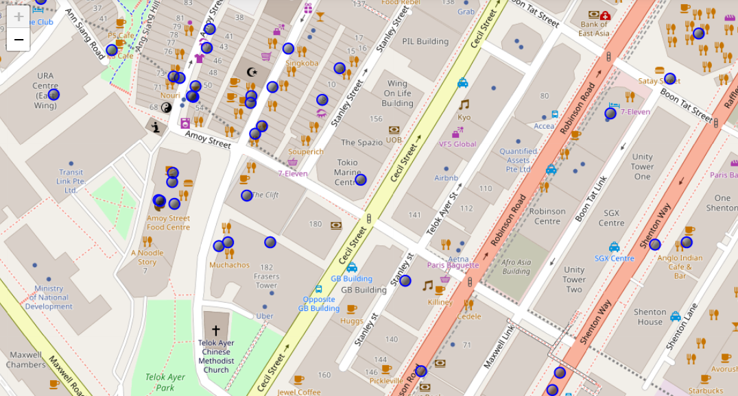
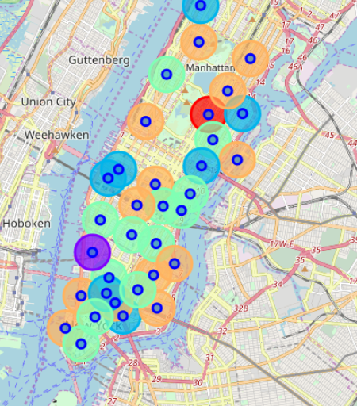
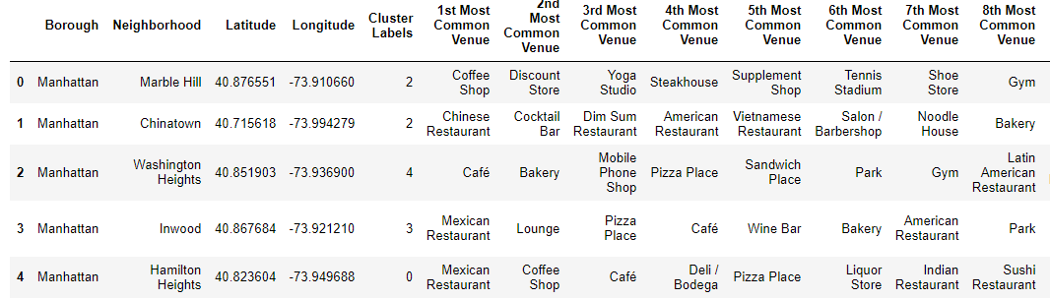
Capstone Project
Venues of the neighbourhood in Singapore and in Manhattan
Manhattan’s cluster 2 is the one which is most similar to Singapore

Slide 5
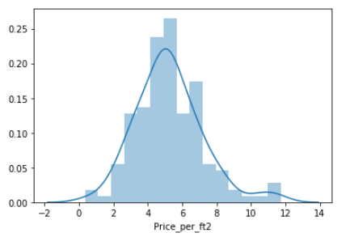
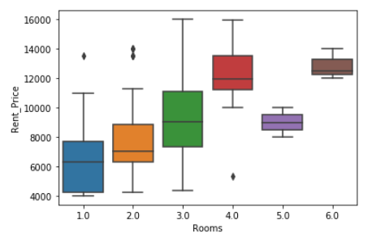
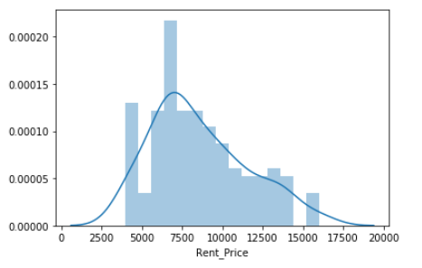
Capstone Project
Rent prices in Manhattan

Slide 6
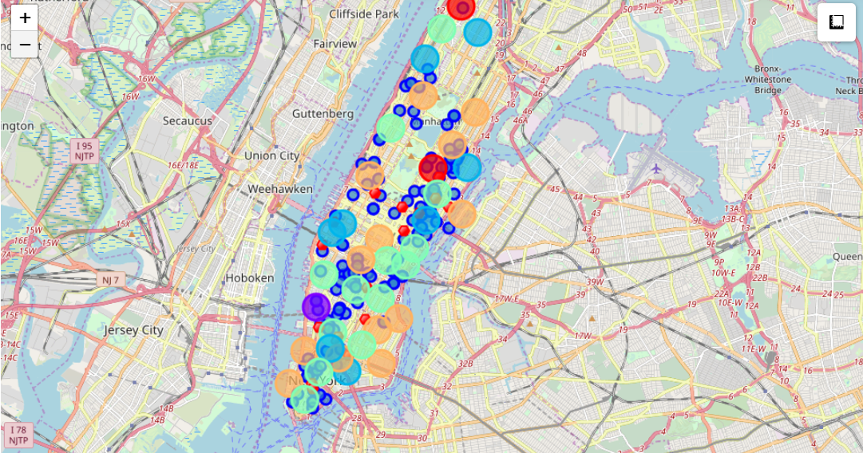
Capstone Project
Map of Manhattan showing places with prices (blue dots), subways (red dots) and cluster of venues
This map allows me to quickly check the best apartments based on my demands

Slide 7
Capstone Project
Results and Conclusions
From the map showed above I was able to quickly select the apartments best fitted my needs.
Apartment on 305 East 63rd Street in the Sutton Place Neighbourhood and near 'subway 59th Street' station, Cluster # 2 Monthly rent : 7500 Dollars
The methodology use allows for a quick and easy selection of apartments while using an interactive map.
Also, it allowed me to compare the similarity of neighbourhoods in different cities.

